Slide 1


Introduction
COMPSCI 453 Computer Networks
Professor Jim Kurose
College of Information and Computer Sciences
University of Massachusetts
Overview. What is the Internet? What is a protocol?
Network edge
Network core
Performance: loss, delay, throughput
Protocol layers, service models
Security
History
Class textbook:
Computer Networking: A Top-Down Approach (8th ed.)
J.F. Kurose, K.W. Ross
Pearson, 2020
http://gaia.cs.umass.edu/kurose_ross

Slide 2
















A closer look at Internet structure
mobile network
Network edge:
hosts: clients and servers
servers often in data centers
national or global ISP
local or regional ISP
home network
content
provider
network
datacenter
network
enterprise
network

Slide 3
A closer look at Internet structure
mobile network
Network edge:
hosts: clients and servers
servers often in data centers
Access networks, physical media:
wired, wireless communication links
national or global ISP
local or regional ISP
home network
content
provider
network
datacenter
network
enterprise
network

Slide 4
A closer look at Internet structure
mobile network
Network edge:
hosts: clients and servers
servers often in data centers
Access networks, physical media:
wired, wireless communication links
Network core:
interconnected routers
network of networks
national or global ISP
local or regional ISP
home network
content
provider
network
datacenter
network
enterprise
network

Slide 5
Access networks and physical media
Q: How to connect end systems to edge router?
residential access nets
institutional access networks (school, company)
mobile access networks (WiFi, 4G/5G)
mobile network
national or global ISP
local or regional ISP
home network
content
provider
network
datacenter
network
enterprise
network

Slide 6
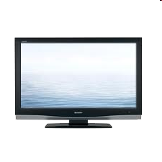



Access networks: cable-based access
cable headend
…
cable
modem
splitter
C
O
N
T
R
O
L
V
I
D
E
O
V
I
D
E
O
V
I
D
E
O
V
I
D
E
O
V
I
D
E
O
V
I
D
E
O
D
A
T
A
D
A
T
A
1
2
3
4
5
6
7
8
9
Channels
frequency division multiplexing (FDM): different channels transmitted in different frequency bands

Slide 7
Access networks: cable-based access
cable headend
…
cable
modem
splitter
CMTS
cable modem
termination system
data, TV transmitted at different
frequencies over shared cable
distribution network
ISP
HFC: hybrid fiber coax
asymmetric: up to 40 Mbps – 1.2 Gbs downstream transmission rate, 30-100 Mbps upstream transmission rate
network of cable, fiber attaches homes to ISP router
homes share access network to cable headend

Slide 8
Access networks: digital subscriber line (DSL)
central office
telephone
network
DSL
modem
splitter
DSLAM
voice, data transmitted
at different frequencies over
dedicated line to central office
ISP
DSL access
multiplexer
use existing telephone line to central office DSLAM
data over DSL phone line goes to Internet
voice over DSL phone line goes to telephone net
24-52 Mbps dedicated downstream transmission rate
3.5-16 Mbps dedicated upstream transmission rate

Slide 9







Access networks: home networks
Wireless and wired
devices
to/from headend or central office
often combined
in single box
cable or DSL modem
WiFi wireless access
point (54, 450 Mbps)
router, firewall, NAT
wired Ethernet (1 Gbps)

Slide 10








Wireless access networks
Shared wireless access network connects end system to router
via base station aka “access point”
Wide-area cellular access networks
provided by mobile, cellular network operator (10’s km)
10’s Mbps
4G cellular networks (5G coming)
Wireless local area networks (WLANs)
typically within or around building (~100 ft)
802.11b/g/n (WiFi): 11, 54, 450 Mbps transmission rate
to Internet
to Internet

Slide 11









Access networks: enterprise networks
Enterprise link to
ISP (Internet)
institutional router
Ethernet
switch
institutional mail,
web servers
companies, universities, etc.
mix of wired, wireless link technologies, connecting a mix of switches and routers (we’ll cover differences shortly)
Ethernet: wired access at 100Mbps, 1Gbps, 10Gbps
WiFi: wireless access points at 11, 54, 450 Mbps

Slide 12
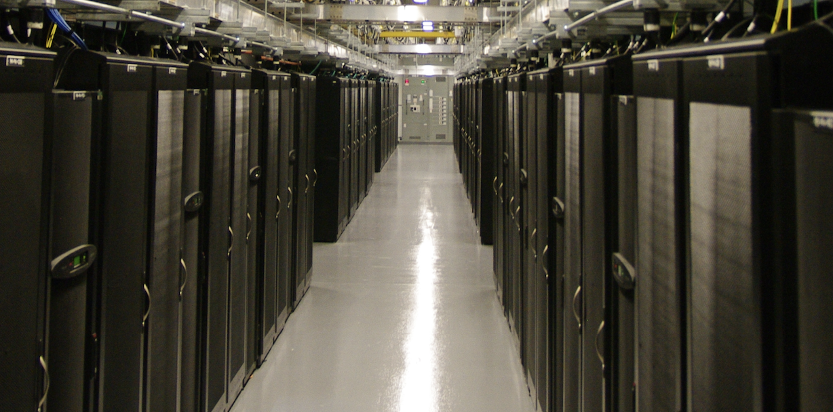
Access networks: data center networks
mobile network
high-bandwidth links (10s to 100s Gbps) connect hundreds to thousands of servers together, and to Internet
national or global ISP
local or regional ISP
home network
content
provider
network
datacenter
network
Courtesy: Massachusetts Green High Performance Computing Center (mghpcc.org)
enterprise
network

Slide 13
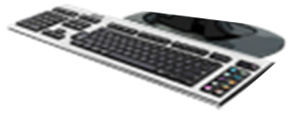
Host: sends packets of data
host sending function:
takes application message
breaks into smaller chunks, known as packets, of length L bits
transmits packet into access network at transmission rate R
link transmission rate, aka link capacity, aka link bandwidth
two packets,
L bits each
2
1
host
R: link transmission rate
packet
transmission
delay
time needed to
transmit L-bit
packet into link
L (bits)
R (bits/sec)
=
=

Slide 14
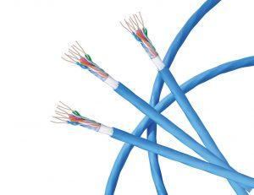
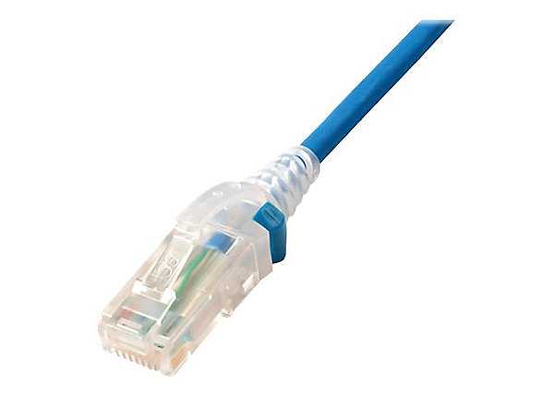
Links: physical media
bit: propagates between transmitter/receiver pairs
physical link: what lies between transmitter & receiver
guided media:
signals propagate in solid media: copper, fiber, coax
unguided media:
signals propagate freely, e.g., radio
Twisted pair (TP)
two insulated copper wires
Category 5: 100 Mbps, 1 Gbps Ethernet
Category 6: 10Gbps Ethernet

Slide 15
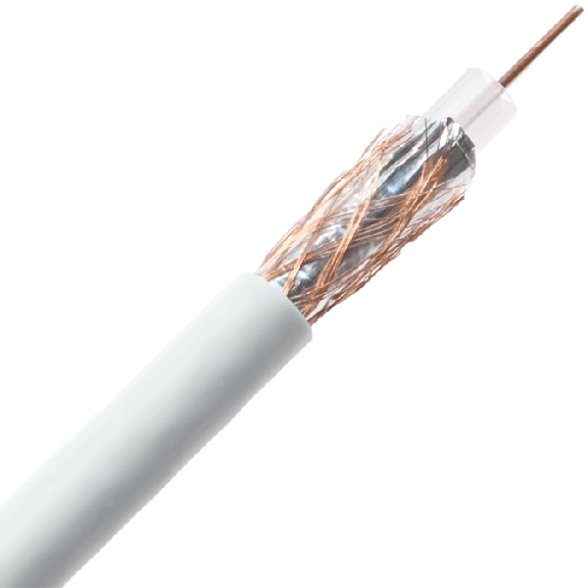
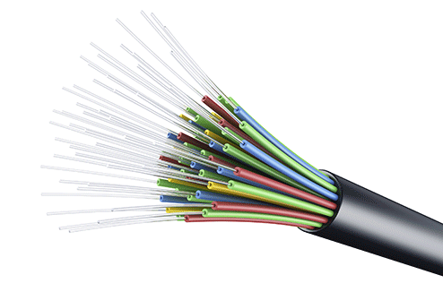
Links: physical media
Coaxial cable:
two concentric copper conductors
bidirectional
broadband:
multiple frequency channels on cable
100’s Mbps per channel
Fiber optic cable:
glass fiber carrying light pulses, each pulse a bit
high-speed operation:
high-speed point-to-point transmission (10’s-100’s Gbps)
low error rate:
repeaters spaced far apart
immune to electromagnetic noise

Slide 16
Links: physical media
Wireless radio
signal carried in various “bands” in electromagnetic spectrum
no physical “wire”
broadcast, “half-duplex” (sender to receiver)
propagation environment effects:
reflection
obstruction by objects
Interference/noise
Radio link types:
Wireless LAN (WiFi)
10-100’s Mbps; 10’s of meters
wide-area (e.g., 4G cellular)
10’s Mbps over ~10 Km
Bluetooth: cable replacement
short distances, limited rates
terrestrial microwave
point-to-point; 45 Mbps channels
satellite
up to 45 Mbps per channel
270 msec end-end delay

Slide 17

Introduction
COMPSCI 453 Computer Networks
Professor Jim Kurose
College of Information and Computer Sciences
University of Massachusetts
Overview. What is the Internet? What is a protocol?
Network edge
Network core
Performance: loss, delay, throughput
Protocol layers, service models
Security
History
Class textbook:
Computer Networking: A Top-Down Approach (8th ed.)
J.F. Kurose, K.W. Ross
Pearson, 2020
http://gaia.cs.umass.edu/kurose_ross
Video: 2020, J.F. Kurose, All Rights Reserved
Powerpoint: 1996-2020, J.F. Kurose, K.W. Ross, All Rights Reserved

